Slide 1
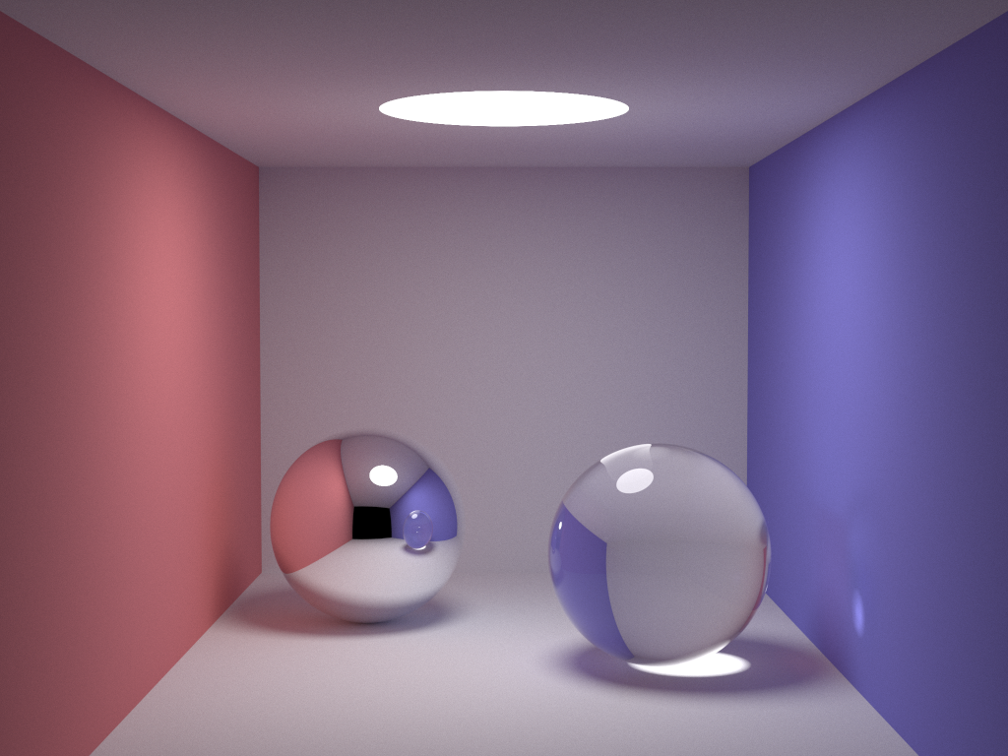
Instant Radiosity

Slide 2
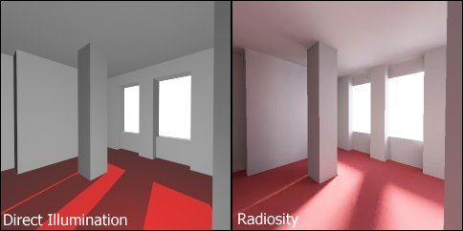
Instant Radiosity Introduction
Instant Radiostiy is a global illumination algorithm in the sense that the illumination arriving at the eye comes not just the light sources, but all the scene surfaces interacting with each other as well. This algorithm has many advantages, for example, easy implementation, converge fast than other global illumination algorithm, low discrepancy and viewpoint independent.
The two pictures on the right rendered by direct illumination and radiosity respectively. The picture using radiosity is more realistic. The shadows are more soft and the light distributed more evenly.

Slide 3
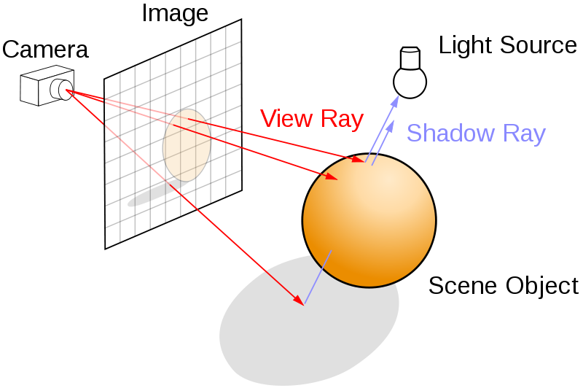
Raytracing
For implementation of the instant radiosity method, we developed a simple ray tracer rather then building the instant radiosity method into an existing raytracer.
General outline of ray tracer:
(1) Shoot ray through each pixel in the image plane.
(2) Find nearest intersecting object.
(3) Accumulate radiance from VPLs and scale the diffuse color by this value.
(4)Set imagebuffer pixel to color generated from ray cast.
Due to time constraints, we wanted to be able to focus more time of implementing the radiance accumulation than additional features of the ray tracer. Because of this, we decided to forgo implementing shadows, ray reflections and ray refractions until we had the general radiance accumulation method working.

Slide 4
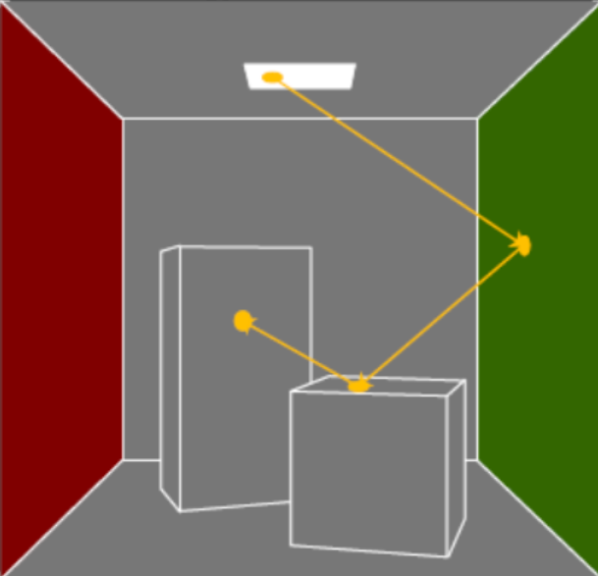
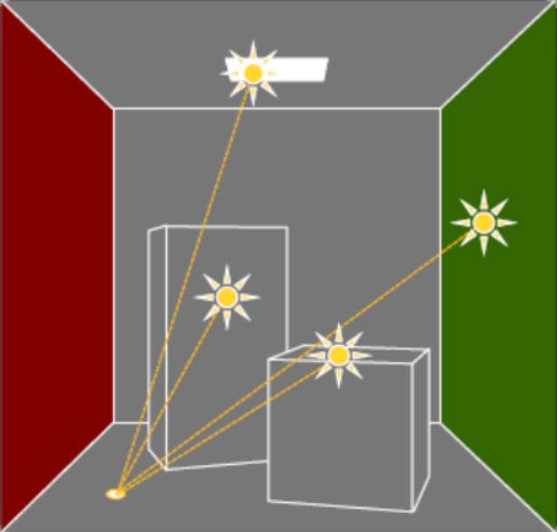
Instant Radiosity Algotihm
Step 1:
(1). Sample the light source and direction;
(2). For each vpl on the path, we first store this vpls’s power and position and then sample its direction using halton sequence and keep tracing
Step 2:
(1). Calculate each intersection point’s radiance by accumulating the contribution from all vpls.
(2). Output the image

Slide 5
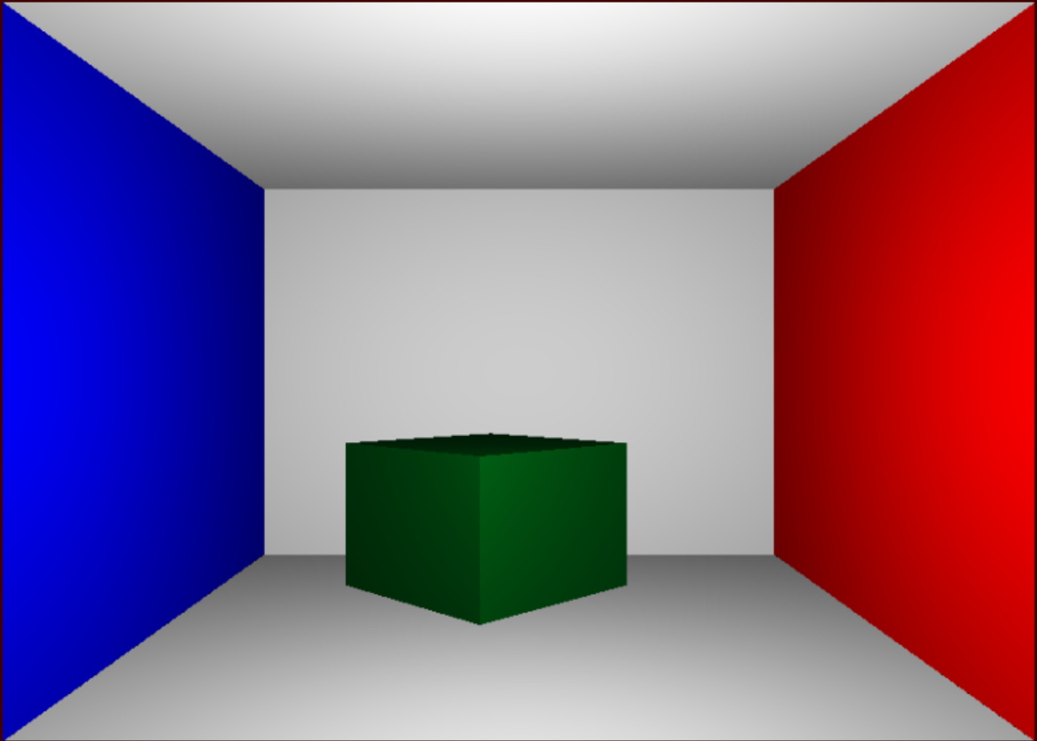
Results
Our best attempt as of turning this project in.
As you can see, there is some lighting effects on the walls and the box that show we are on the right path of implementing instant radiosity

Slide 6
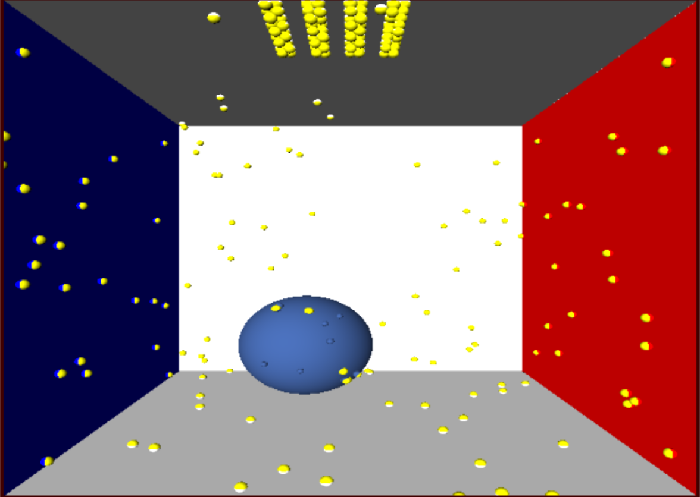
Results
This is a visualization to show the distribution of virtual point lights emitted into the scene.

Slide 7
Future work
1. Find a correct approach to accumulate each point’s radiance.
2. Add shadow, reflection and refraction.
3. Parallel this method to try to run it in real-time
4. Improving sample strategy.

